Slide 1
Topic 2: Software Processes & Process Models

Slide 2
Waterfall Model

Slide 3
Waterfall Model
A linear and sequential software development approach.
A phase cannot begin until the previous phase is completed.
No overlapping of phases is allowed.
A step-by-step flow, similar to water falling from a cliff—it cannot go back up.
The output of one phase serves as the input for the next phase.
Commonly used for small and well-defined projects with clear requirements.

Slide 4
Aspect | ✅ Advantages | ❌ Disadvantages
Simplicity | Easy to understand & implement. | Too rigid and inflexible for real-world applications.
Best for Small Projects | Works well for small & defined projects. | Not suitable for large or complex systems.
Management | Easy to manage with clear phases. | Changes are difficult to implement.
Structured Approach | Each phase is well-documented and follows a logical order. | No overlapping of phases, which slows down development.
Requirement Stability | End goal is determined early, avoiding scope creep. | Requires complete & accurate requirements upfront, which is often unrealistic.
Testing | Testing is done after development, reducing confusion. | Testing occurs late, making error detection costly.
Risk Management | Basic framework for other models | Risks are not assessed, leading to high uncertainty.
Time to Market | Predictable timeline due to its structured nature. | Working software is not available for a long time, delaying user feedback.

Slide 5
V Model (Verification and Validation Model)

Slide 6
V Model (Verification and Validation Model)
A structured and disciplined SDLC approach.
A sequential execution - each phase starts only after the previous phase ends.
Testing is integrated with development - each development phase has a corresponding testing phase.
The model forms a V-shape, where:
  Left side → Represents development activities.
  Right side → Represents testing activities.
  Coding phase → Acts as the connection between both sides.
Ensures early defect detection and better quality control.
Works best for small to medium-sized projects with well-defined requirements.

Slide 7
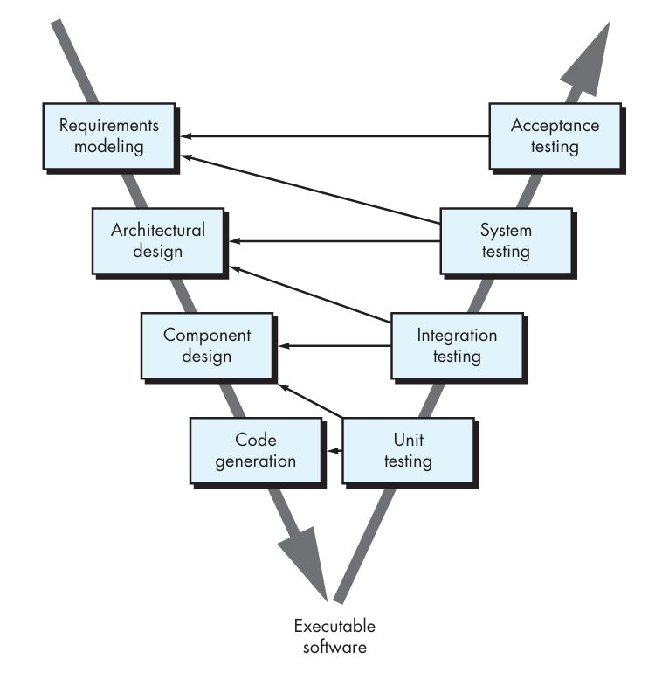

Slide 8
Aspect | ✅ Advantages | ❌ Disadvantages
Simplicity | Easy to use and understand. | Not suitable for complex projects.
Early Testing | Testing activities start before coding, ensuring better quality. | Changes in requirements are difficult to accommodate.
Discipline | Follows a well-structured phase-by-phase development and testing process. | High risk and uncertainty if requirements are not well-defined.
Defect Detection | Bugs are caught early, reducing cost and effort. | Not flexible for iterative or ongoing projects.
Best for Small & Medium Projects | Works well for small and medium-scale development. | Not suitable for large-scale, evolving projects.

Slide 9
Incremental Model

Slide 10
Incremental Model
Divides the development process into multiple increments (modules/builds).
Each increment follows the same SDLC phases (Requirement Analysis, Design, Implementation, Testing, Deployment).
Development happens in small parts, making it suitable for complex projects.
Instead of building the entire software at once, modules are delivered in stages, incorporating customer feedback.
The process involves:
  Developing an initial version with core functionalities.
  Gathering user feedback and refining the system.
  Adding more modules in each increment until the final system is complete.
Each new release builds on the previous one, ensuring gradual improvement.
Important functionalities are prioritized and developed in early iterations.

Slide 11
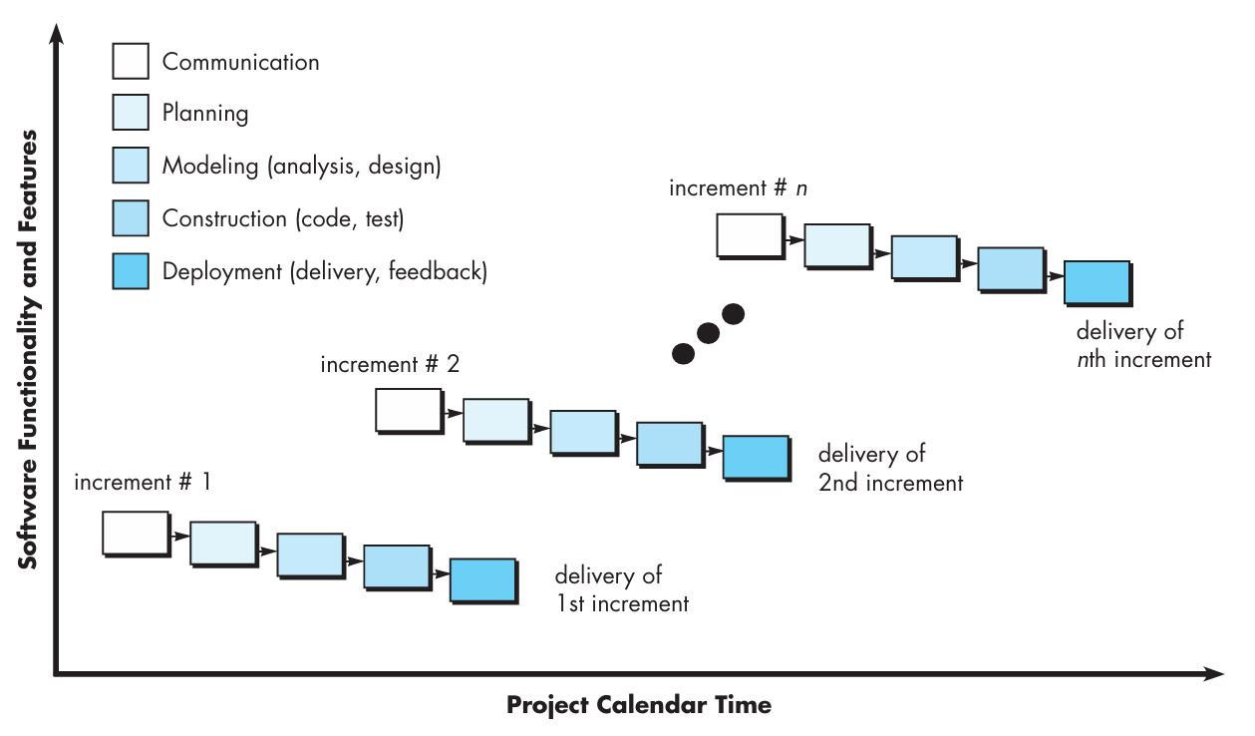

Slide 12
Aspect | ✅ Advantages | ❌ Disadvantages
Development Approach | Critical modules are developed first, ensuring early functionality. | Requires complete clarity of overall software requirements before starting.
Early Working Software | Software is available early in the SDLC. | Needs continuous management and coordination.
Flexibility | Easy to modify scope and requirements. | Requires careful planning and design.
Customer Feedback | Users can review each module and suggest changes. | Late-stage changes may still impact overall system integration.
Progress Measurement | Project progress is easily trackable. | Total cost may be higher compared to simpler models.
Testing & Debugging | Easier to test and debug smaller iterations. | May lead to rework if early increments are not well-integrated.
Error Detection | Defects can be identified early. | Integration of multiple increments can be challenging.

Slide 13
Iterative Models

Slide 14
Evolutionary/Iterative Models
The Iterative Model involves repeated cycles (iterations) of software development.
Developed in small, manageable portions, allowing for frequent reviews & changes.
Process:
  Develop a version of the software with initial requirements.
  Review the version and identify required changes.
  Based on feedback, create a new version in the next iteration.
  Repeat this process until the final product meets all requirements.
Unlike the Waterfall Model, the Iterative Model allows for continuous improvement through each cycle.
Basic Concept: Develop software in small parts (iterations), making adjustments after each cycle.
Goal: Address the drawbacks of Waterfall by providing flexibility to adapt to changing requirements.

Slide 15
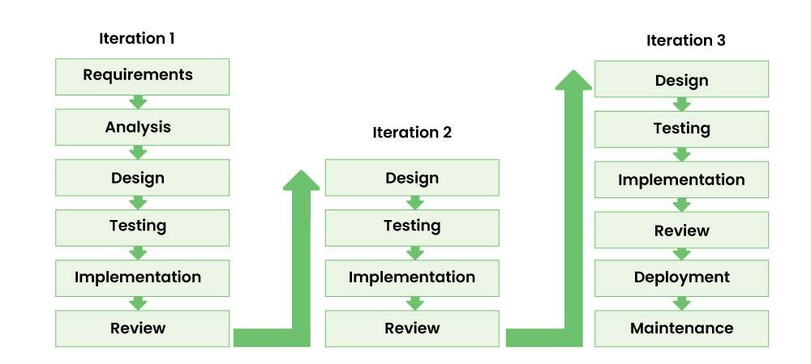

Slide 16
Aspect | ✅ Advantages | ❌ Disadvantages
Bug Detection | Errors and bugs are identified early in iterations. | Requires more resources due to repeated iterations.
Faster Development | Basic working software is available quickly. | Not suitable for small projects.
Testing & Debugging | Easier to test and debug in each iteration. | Frequent changes in requirements lead to increased effort.
User Feedback | Users provide feedback during development, improving final product quality. | Constant changes can increase project budget and timeline.
Flexibility | Adapts well to changing requirements. | Managing the entire process is complex.
Less Documentation | More focus on development, less time on documentation. | Hard to predict the exact completion date.
Risk Management | Risks are identified and resolved early. | Requires careful planning and coordination.

Slide 17
Prototyping Model is an Iterative Model

Slide 18
Prototyping Model
Creating a prototype of the software application before the final product is developed.
It is especially useful when the requirements are unclear or not well-defined.
The prototype serves as a working model for understanding user needs, allowing for iterative refinement.
Key Features:
  A prototype is created based on the initial requirements.
  The final product is developed based on feedback from the prototype.
  Can be used with other SDLC models or as a standalone approach.
Challenges:
  If end-users are unsatisfied, a new version must be created, which can lead to increased costs and time.
  Requires careful management of user expectations to avoid excessive iterations.
Developed to overcome the limitations of the Waterfall Model, especially when dealing with uncertain or evolving requirements.

Slide 19
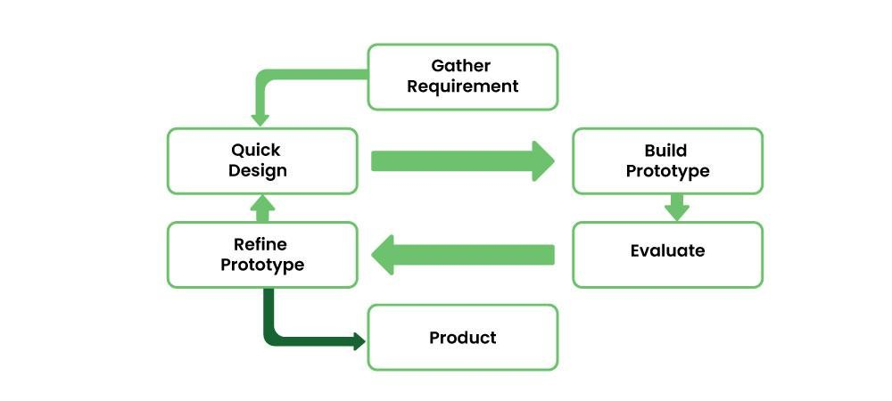

Slide 20
Aspect | ✅ Advantages | ❌ Disadvantages
User Interaction | Best suited for applications requiring human-machine interaction. | Customers may focus on minor fixes instead of allowing a full system redesign.
Handling Unclear Requirements | Useful when only general objectives are known but details (input, processing, output) are unclear. | The first version may include many compromises.
Testing Feasibility | Helps developers evaluate algorithm performance and OS adaptability. | Developers may make shortcuts just to get a prototype working, leading to poor long-term quality.
Early User Feedback | Users can review and suggest changes early in development. | Too many iterations can delay final product delivery.
Risk Reduction | Helps identify potential risks early. | Not suitable for projects requiring strict documentation and planning.

Slide 21
Types of Prototyping

Slide 22
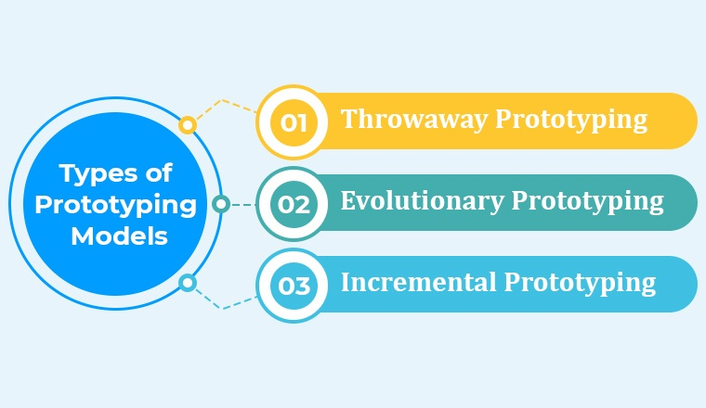

Slide 23
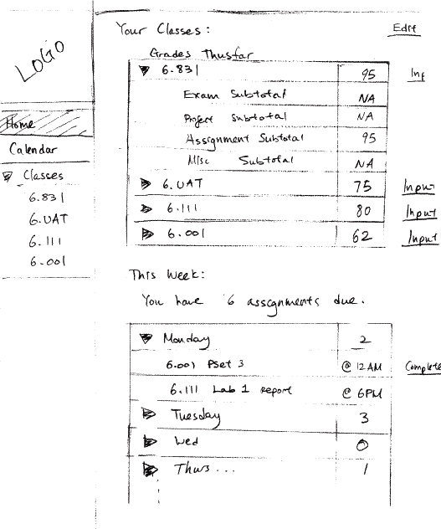
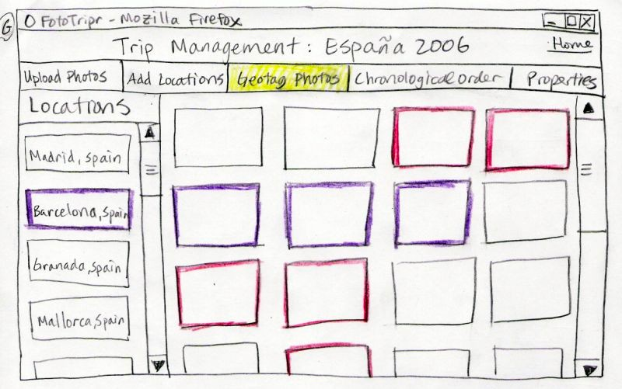
Rapid Prototyping Techniques
Sketches

Slide 24
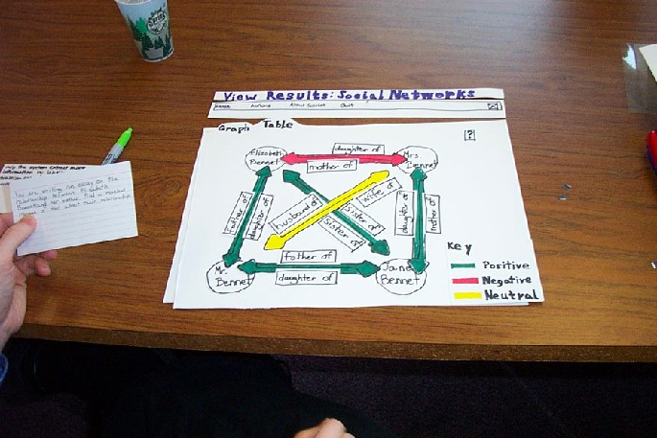
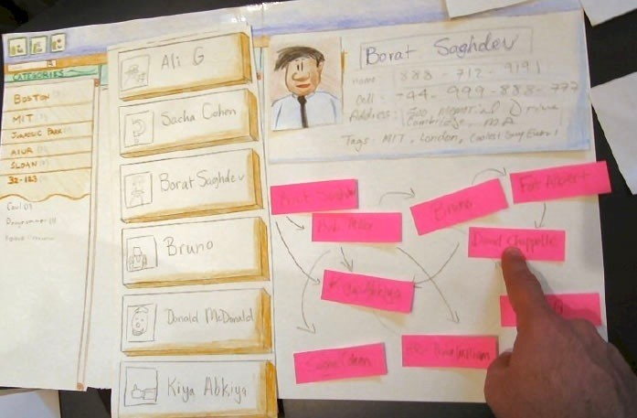
Rapid Prototyping Techniques
Paper Prototypes

Slide 25
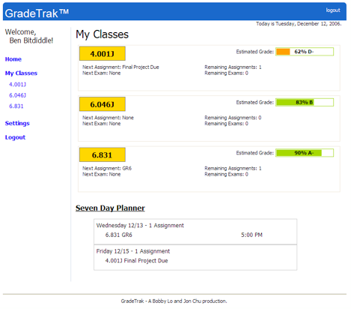
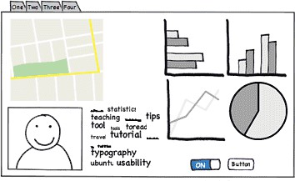
Rapid Prototyping Techniques
Wireframes and Digital Mockups

Slide 26
Rapid Prototyping Techniques
Throwaway Code
  Quick low-quality code is written just to demonstrate functionality.
  Used in software engineering to test algorithms or interactions.
3D Prototyping (For Hardware & VR Systems)
  Used for hardware, IoT, or game development.

Slide 27
Component Assembly Model

Slide 28
Component Assembly Model
The Component Assembly Model is based on reusing existing software components instead of building everything from scratch.
It follows the principle of “develop once, reuse multiple times.”
Similar to how hardware engineers assemble circuits using pre-built chips, this model assembles software systems using pre-made components (modules, libraries, APIs, frameworks).

Slide 29
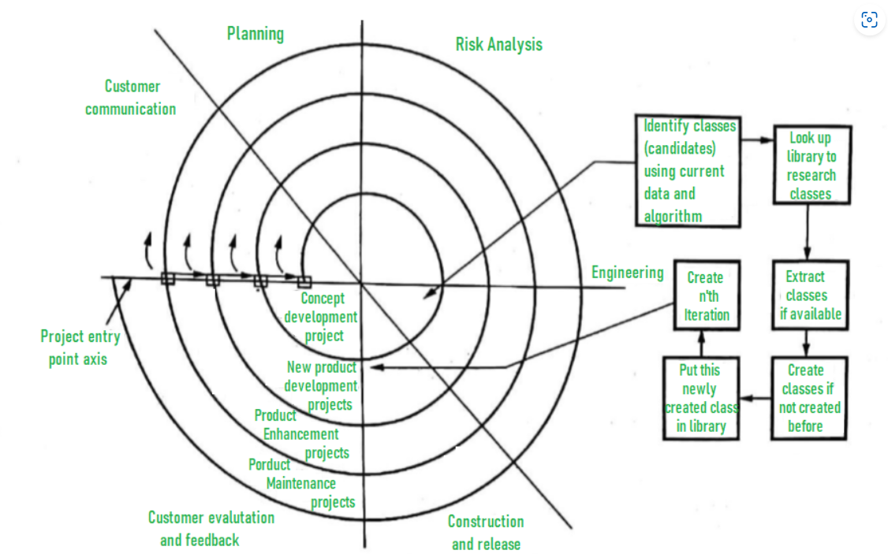

Slide 30
Component Assembly Model
Aspect | ✅ Advantages | ❌ Disadvantages
Development Speed | Faster development by reusing components. | Hard to find the perfect component match.
Cost Savings | Reduces cost as components are pre-built. | Licensing fees may apply for third-party components.
Software Quality | Components are tested and reliable. | Compatibility issues when integrating multiple components.
Maintenance | Easier updates by replacing/upgrading components. | Risk of dependency on third-party providers.
Flexibility | Modular design allows easier modifications. | Less control over third-party components' internals.

Slide 31
When to Use the Component Assembly Model?
When there are existing reusable components that fit the project’s needs.
When fast development is required (e.g., startups, rapid prototyping).
For large, scalable systems where modularity is important.
In app development, where frameworks and APIs are widely available.

Slide 32
Rapid Application Development (RAD) Model

Slide 33
Rapid Application Development (RAD) Model
A fast-paced software development approach.
Similar to Incremental and Waterfall Models but focuses on speed & flexibility.
Best suited for small projects; large projects are broken into smaller parts and completed iteratively.
Key Features:
  Fast Development – Projects are completed quickly.
  Predefined Requirements – All requirements are gathered before development begins.
  Low Error Rate – Rapid development reduces errors.
  Reuse of Code & Components – Maximizes efficiency by reusing tools and processes.
Ensures timely delivery while maintaining quality and flexibility.

Slide 34
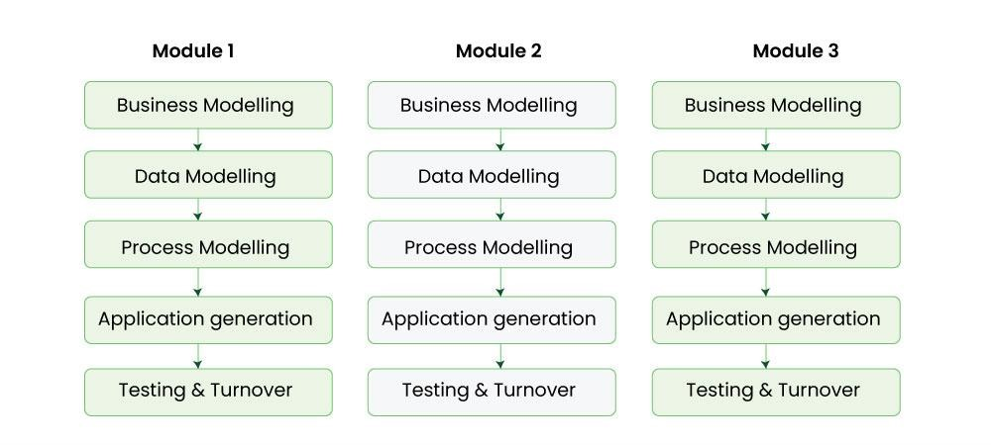

Slide 35
Aspect | ✅ Advantages | ❌ Disadvantages
Development Speed | Reduces development time significantly. | Requires highly skilled devs and designers.
Reusability | Components are reused, reducing redundancy. | Not suitable for complex, long-term projects.
Flexibility | Easy to modify and update during development. | Difficult to manage due to rapid iterations.
Portability | Uses high-level abstraction and intermediate code, making it easy to transfer. | Automated code generation tools can be expensive.
Quality & Defects | Prototype-based approach minimizes defects. | Requires constant client feedback.
Efficiency | Achieves high productivity with fewer people. | Works only for component-based and scalable systems.
Cost Effectiveness | Reduces overall project costs. | Not ideal for projects with undefined or frequently changing requirements.
Best for Small Projects | Works well for small, well-defined applications. | Unsuitable for large-scale enterprise systems.

Slide 36
THANK YOU

